Slide 1
Tuesday, January 17
Do Now:
SSR-15
Homework:
VOCABULARY QUIZ TOMORROW!
Objective:
I will use my knowledge of persuasion techniques to analyze and comprehend MLK Jr’s speech about Jazz.
Today you will need:
Chromebook
Pencil
Highlighter (3 colors)

Slide 2
Grammar Keeper
We are going to try a new approach to grammar keepers. Each week I will assign a Grammar Keeper (commas in a list) and each day, you will need to provide an example of it being used correctly. If you don’t know the rule…look it up ☺

Slide 3
Sacred Writing
Write a poem.
It does NOT HAVE to rhyme.
It does need to be more than 2 lines.
Make it meaningful. Be prepared to share.

Slide 4
DOL
You will have 2 paragraphs a week. It is expected that you will be done with both paragraphs to review on Friday. Friday will be spent discussing, the work must be done Monday-Thursday. No more hints beyond what the paper give you…you got this!

Slide 5
Tricky Tuesday
I have streets but no pavement, I have cities but no buildings, I have forests but no trees, I have rivers yet no water.
What am I?

Slide 6
Persuasion Techniques

Slide 7
Persuasion Techniques
Persuasion techniques are used to sway your heart or mind
Some techniques help to make strong arguments better or can disguise weak arguments
Faulty reasoning- claim based on information that is incorrect, biased, or simply doesn’t make sense
Rhetorical Fallacy
An un-sound argument that still may be convincing
PATHOS, LOGOS, ETHOS
Handout- Selective HIghlighting

Slide 8
Emotional Appeals- PATHOS
Use strong feelings, rather than facts and evidence, to persuade
Appeal to Fear
Appeal to Vanity
Appeal to Pity
Snob Appeal
Plain Folks

Slide 9
Loaded Language
Relies on words with strong positive or negative associations
Words with Positive Associations- bring to mind something exciting, comforting, or desirable
Words with Negative Associations- call up unpleasant images, experiences, or feelings

Slide 10
Word Choice
Connotation vs. Denotation
Figurative Language
Sound Devices
Repetition- importance
Alliteration
Rhyme
Onomatopoeia

Slide 11
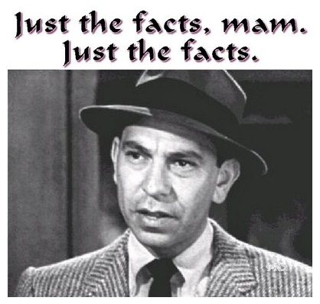
Logical Appeals- LOGOS
Uses reasoning and facts or examples to persuade
Appeal to logic- using logical reasoning to argue a point of view- offers valid facts and sound reasoning

Slide 12
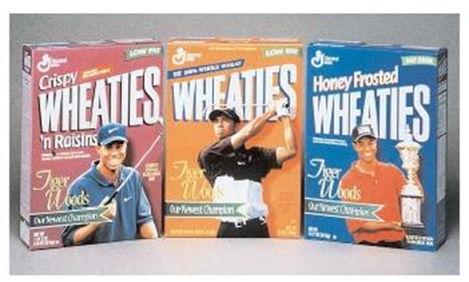
Appeals To Ethics- ETHOS
Uses professional credentials, association with an authorities, or connections to a higher power to persuade
“Sell” a product or an idea by linking it with something or someone positive or influential
Bandwagon- taps into people’s desires to belong to a group
Testimonial- relies on the backing of a celebrity, an expert, or a satisfied customer

Slide 13
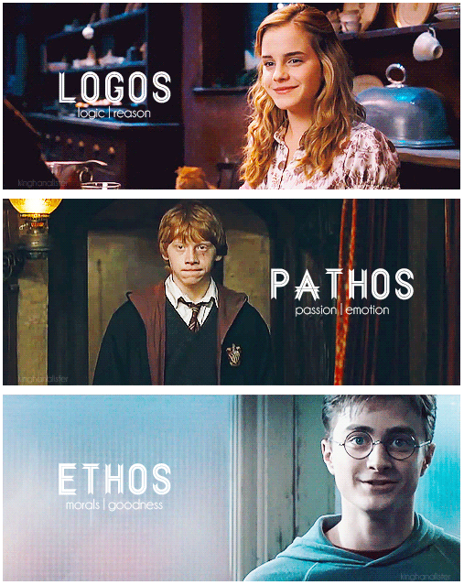

Slide 14
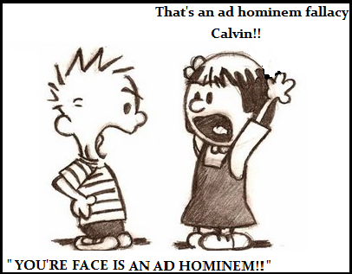
Ad Hominem
A type of rhetorical fallacy where the intent is to attack someone or a situation who is for a position in order to distract from the argument.
This attack is usually personal in nature and meant to devalue the claim.

Slide 15
Other…
Counter Arguments- Opposing the given view point
Claim- states the writer’s position on an issue
Support- reasons or evidence that is part of the argument
Explicit Message
Specific, clear, detailed, lives little room for interpretation
Implicit Message
Uses visual, body language to communicate meaning

Slide 16
Analyzing for Persuasion
Content: identify the topic, issue, or problem
Purpose: does the author have any other purpose outside of persuasion?
Argument: what is the author’s claim or position? Evidence?
Reasoning and Logic: author’s mode of reasoning?
Persuasive Techniques: logical appeal? (Logos) Emotional appeal? (Pathos) Appeal through authority? (Ethos)
Evaluation: Are you persuaded to adopt the author’s position? Did it work?

Slide 17
Martin Luther King Jr.
Share what you know at your table groups for 2 minutes.

Slide 18
Martin Luther King Jr.
Berlin Jazz Festival -- What is it?

Slide 19
Martin Luther King Jr.
"God has wrought many things out of oppression. He has endowed his creatures with the capacity to create-and from this capacity has flowed the sweet songs of sorrow and joy that have allowed man to cope with his environment and many different situations." "Jazz speaks for life. The Blues tell the story of life's difficulties, and if you think for a moment, you will realize that they take the hardest realities of life and put them into music, only to come out with some new hope or sense of triumph. This is triumphant music." "Modern Jazz has continued in this tradition, singing the songs of a more complicated urban existence. When life itself offers no order and meaning, the musician creates an order and meaning from the sounds of the earth which flow through his instrument." "It is no wonder that so much of the search for identity among American Negroes was championed by Jazz musicians. Long before the modern essayists and scholars wrote of racial identity as a problem for a multiracial world, musicians were returning to their roots to affirm that which was stirring within their souls. Much of the power of our Freedom Movement in the United States has come from this music. It has strengthened us with its sweet rhythms when courage began to fail. It has calmed us with its rich harmonies when spirits were down. And now, Jazz is exported to the world. For in the particular struggle of the Negro in America there is something akin to the universal struggle of modern man. Everybody has the Blues. Everybody longs for meaning. Everybody needs to love and be loved. Everybody needs to clap hands and be happy. Everybody longs for faith." "In music, especially this broad category called Jazz, there is a stepping stone towards all of these." "We must use time creatively." - Martin Luther King, Jr

Slide 20
Wednesday, January 18
Do Now:
SSR-15
You will complete the SSR check-in form today on classroom (under “about” section). For today, make sure you click “no” on the first question.
Homework:
None ☺
Objective:
I will use my knowledge of mythology to analyze myths, legends, and fables from multiple cultures and compare their elements.
Today you will need:
Chromebook
Colors
Pencil

Slide 21
Grammar Keeper
We are going to try a new approach to grammar keepers. Each week I will assign a Grammar Keeper (commas in a list) and each day, you will need to provide an example of it being used correctly. If you don’t know the rule…look it up ☺

Slide 22
Sacred Writing
Write a poem.
It does NOT HAVE to rhyme.
It does need to be more than 2 lines.
Make it meaningful.

Slide 23
DOL
You will have 2 paragraphs a week. It is expected that you will be done with both paragraphs to review on Friday. Friday will be spent discussing, the work must be done Monday-Thursday. No more hints beyond what the paper give you…you got this!

Slide 24
Wicked Word Wedensday
Vocabulary Quiz on Google Classroom

Slide 25
Stylistic Elements of Myths
Passed down orally in various cultures. Why??

Slide 26
Stylistic Elements of Myths: Characterization
Features gods, goddesses, and other beings with extraordinary powers.
Often times, these characters have the same emotions and weaknesses as humans.
Typical types of characters:
normal people
gods or goddesses
monsters or creatures

Slide 27
Stylistic Elements of Myths: Cause and Effect
Explains how something in the world came to be
There is often a cause and effect relationship highlighted
transformations, magic and trickery, gods and goddesses
Supernatural or Magical Elements
What is the myth explaining?

Slide 28
Example...
Echo and Narcissus

Slide 29
Narcissus was a beautiful looking boy. He had long, flowing, blond hair, beautiful, bright, blue eyes and even, white teeth. Many young ladies fell in love with him including the nymph; Echo. Nymphs were lively spirits who lived near streams and lakes and protected trees in the forest. Echo had upset the Queen of the Gods; Hera. As a punishment Hera made Echo unable to speak except to repeat the last three words of the person she was talking to.
Poor Echo fell in love with Narcissus but could never tell him how she felt. Narcissus teased her and she ran away with tears pouring down her face. Aphrodite, the goddess of love saw what happened and decided to punish Narcissus. As he came to a pool of water Narcissus saw his reflection and fell in love with the vision he saw...it was of course his own reflection.
Poor Narcissus watched his own reflection, every time he tried to touch the face of the vision he loved it broke up on the shimmering surface of the water. Narcissus stopped eating, lost his beautiful looks and pined for his love. Eventually he faded away and died.
Aphrodite took pity on him and made a flower grow in his place on the bank of the lake. Narcissus flowers can be found to this day growing wherever you can find water and trees.

Slide 30
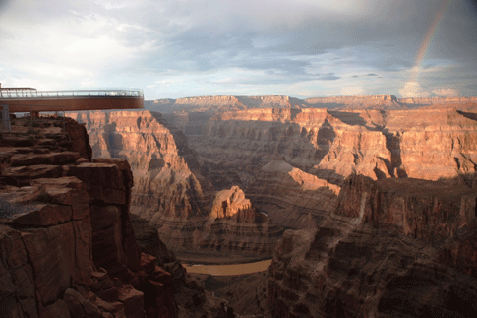
Echo

Slide 31
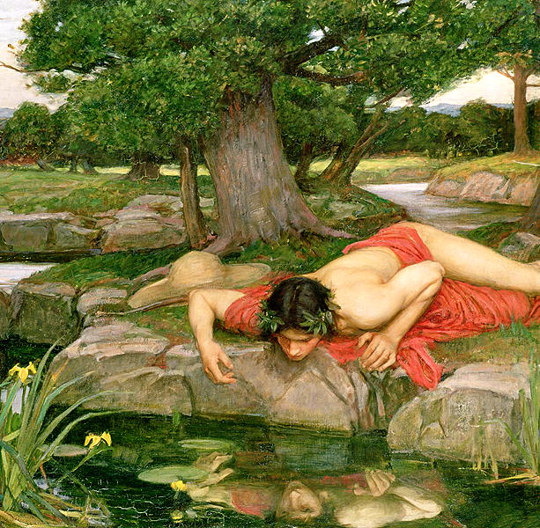
Narcissus

Slide 32
Stylistic Elements of Myths: Cultural Values
The theme is taught through the cultural value
Cultural values are the standards of behavior that a society expects from its people.
Some values often taught in Greek and Roman Myths are:
Respecting your elders
Respecting and obeying the gods, who are often involved in humans everyday lives
Knowing your place

Slide 33
Return with Elixir
Ordinary World
Call to Adventure
Refusal of the Call
Resurrection
Reward/Road Back
Mentor
Approach/Ordeal
Crossing the Threshold
Tests, Allies, Enemies

Slide 34
HERO’S JOURNEY POSTER
Groups of 3
You will fill out the graphic organizer AND
Create a poster depicting the journey.
You may use the internet to help you.
You may pick from the following movies OR submit your own request for approval :
Mulan, Finding Nemo, Lion King, Beauty and the Beast, Harry Potter, Hercules, Aladdin, Jungle Book

Slide 35
Thursday, January 19
Do Now:
SSR-15
Homework:
None ☺
Objective:
I will use my knowledge of mythology to analyze myths, legends, and fables from multiple cultures and compare their elements.
Today you will need:
chromebook

Slide 36
Grammar Keeper
We are going to try a new approach to grammar keepers. Each week I will assign a Grammar Keeper (commas in a list) and each day, you will need to provide an example of it being used correctly. If you don’t know the rule…look it up ☺

Slide 37
Sacred Writing
Write a poem.
It does NOT HAVE to rhyme.
It does need to be more than 2 lines.
Make it meaningful. Be prepared to share.

Slide 38
DOL
You will have 2 paragraphs a week. It is expected that you will be done with both paragraphs to review on Friday. Friday will be spent discussing, the work must be done Monday-Thursday. No more hints beyond what the paper give you…you got this!

Slide 39
Tipster Thursday
Make sure you know what part of speech a word is. This will determine HOW you use it.

Slide 40
Medieval Heroes
Medieval Heroes differ slightly from Heroes in traditional Greek and Roman mythology.
Medieval Heroes have 5 similar characteristics amongst themselves.

Slide 41
Characteristics of Medieval Heroes
A hero can be of common birth.
Battle is an ongoing test of manhood and loyalty to their lord.
A man has to be seen as having a good moral character
Must demonstrate obedience to hierarchy
Wages war on behalf of their lord principles–war is no longer a land grab or to avenge honor.

Slide 42
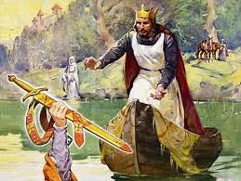
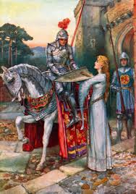
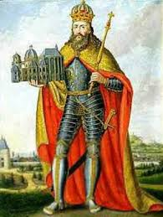
Examples of Medieval Heroes
King Arthur
Sir Lancelot
Charlemagne

Slide 43
Modern Medieval Ideals
Real Life -- Soldiers– can come from common background, listen to their commander, uphold morals, fight for the “kingdom”
Media – Once Upon A Time
Literary – Freak the Mighty

Slide 44
Your Turn...
Select one of the following cultures and research the history of their mythology. Look for common themes, characters, methods, and background.
You will share your culture and myth background with the class on Friday.
Options:
Japanese, Indian, Native American, Chinese, Aboriginal, Aztec/Mayan

Slide 45
Friday, January 20
Do Now:
SSR-10
SSR Check-in when finished
Homework:
Cultural Research/Hero’s Journey poster if not done
Objective:
I will use my knowledge of mythology to analyze myths, legends, and fables from multiple cultures and compare their elements.
Today you will need:
chromebook

Slide 46
Your Turn...
Select one of the following cultures and research the history of their mythology. Look for common themes, characters, methods, and background.
You will share your culture and myth background with the class on Friday.
Options:
Japanese, Indian, Native American, Chinese, Aboriginal, Aztec/Mayan

